Slide 1
Classes and Objects

Slide 2
Topics
The Class Definition
Declaring Instance Member Variables
Writing Instance Member Methods
Creating Objects
Sending Messages to Objects
Constructors
Static Data and Static Methods

Slide 3
Objectives
At the completion of this topic, students should be able to:
Design and use programmer written classes in a C# program
Correctly declare instance member data in a class
Correctly write instance member methods in a class
Correctly create objects (instance of a class)
Correctly send messages to objects
Correctly write and use constructors
Explain the use of static data and static methods

Slide 4
Consider the UML class
Diagram for a Book Class
Book
title: string
price: double
rating: double
+ Book( )
+ Book(:string, :double, :double)
+ GetTitle( ): string
+ SetTitle(:string): void
+ GetPrice( ): double
+ SetPrice(:double): void
+ CalcScore(: ): void

Slide 5
To start a class definition
The keyword “class”
The class name we have chosen
class Book
{
}
A set of curly braces …
The body of the class
will go in between them.

Slide 6
Declaring Member Data
Member data is “private”
class Book
{
private string title;
}
data type
variable name
Indent each line inside the block

Slide 7
Declaring Member Data
class Book
{
private string title;
}
We call data members of a class “Instance Data”
because each instance (object) of the class
will contain its own unique copy of this data.

Slide 8
Declaring Member Data
class Book
{
private string title;
private double price;
private double rating;
}

Slide 9
Declaring Member Methods
class Book
{
private string title;
private double price;
private double rating;
public void SetTitle( string t)
{
}
}
Member methods are
usually public
parameters
method name
return type

Slide 10
Declaring Member Methods
class Book
{
private string title;
private double price;
private double rating;
public void SetTitle( string t)
{
. . .
}
}
The body of
the method goes
between these
curly braces

Slide 11
“Getter”Methods
they are usually named
“get” plus the name of the
instance variable they
will return the value of.
class Book
{
. . .
public string GetTitle( )
{
return title;
}
}
getters take no
parameters
getters always
return something

Slide 12
“Setter”Methods
they are usually named
“set” plus the name of the
instance variable they
will return the value of.
class Book
{
. . .
public void SetTitle(string t )
{
title = t;
}
}
setters never
return anything
setters always take
a parameter
The value of the parameter is
stored in an instance variable.

Slide 13
Don’t forget the method prologue
// the setTitle method
// Purpose” to set the title of a book object
// Parameters: the title to set, as a string
// Returns: Nothing
public void SetTitle(string t )
{
title = t;
}

Slide 14
Data Manipulation Methods
class Book
{
. . .
public double CalcScore( )
{
double score = rating / price;
return score;
}
}
They usually take no parameters
They work on the data inside
of the object and do some
calculation
They usually
return something

Slide 15
Creating Objects

Slide 16

Class definition
Class Book
{
private string title;
private double price;
private double rating;
. . .
}
Book nextBook = new Book( );
this statement takes the Book class
definition and uses it to create
the object “nextBook”.
When creating the object, storage
is allocated for each of the data
members defined in the class.
Each data member is initialized to
a standard default value.
title
price
rating
nextBook

Slide 17
Sending Messages to Objects

Slide 18
parameters
nextBook.SetTitle(“C# for Everyone” );
.
message
object
name
Method
name
title
price
rating
nextBook

Slide 19
nextBook.SetTitle(“C# for Everyone” );
This statement send the SetTitle
message to the object named nextBook.
As the method executes, the value of
the parameter t is stored in the
instance variable title.
message
title
price
rating
void SetTitle(string t)
{
title = t;
}
nextBook

Slide 20
Constructors
Creating objects with un-initialized member data can be dangerous.
The instance variables in the object may not be set to what you
expected.
Constructors provide us with a handy way to initialize member data
when an object is created.

Slide 21
Important Note: Constructors don’t create
objects! They are used to initialize data
in an object.

Slide 22
Constructor Definitions
A constructor is a member method of a class, but it has
two unique qualities:
* It must have the same name as the class
* It has no return type ( not even void)

Slide 23
class Book
{
private string title;
private double price;
private double rating;
public Book( )
{
. . .
}
}
This is the constructor for the Book class.
Notice that it has the same name as the class
and has no return type.

Slide 24
In a default (non-parameterized)
constructor set values to
reasonable default values.
class Book
{
private string title;
private double price;
private double rating;
public Book( )
{
title = “none”;
price = 0.0;
rating = 0;
}
}

Slide 25
class Book
{
private string title;
private double price;
private double rating;
public Book( )
{
title = “none”;
price = 0;0;
rating = 0;
}
public Book(string t, double pr, double rt )
{
title = t;
price = pr;
rating = rt;
}
}
Constructors can be overloaded

Slide 26
class Book
{
private string title;
private double price;
private double rating;
public Book( )
{
title = “none”;
price = 0;0;
rating = 0;
}
public Book(string t, double pr, double rt )
{
title = t;
price = pr;
rating = rt;
}
}
This constructor stores values
that are passed as parameters

Slide 27
You do not have to write a constructor if
you are happy with the default values that
the compiler uses. The compiler builds a
default constructor for you.

Slide 28
However … if you write a parameterized constructor
you should also write your own default constructor.
the compiler won’t create one for you.

Slide 29
Connecting the class to the User Interface
Remember that good program design means separating the
user interface logic from the business logic of the program.
but how do we connect the two things together to make the
program work?

Slide 30
The Form object –
manages the user
interface
An object that provides
the business logic for
the application

Slide 31
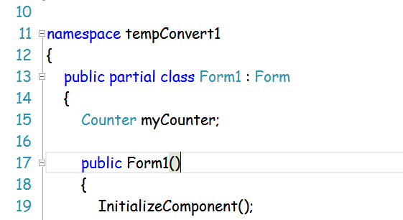
Form Class Code
Create a reference to an
object of your class.
Create a reference to an object of your class.
By making the reference at the class level,
it can be seen by every method in the Form.

Slide 32
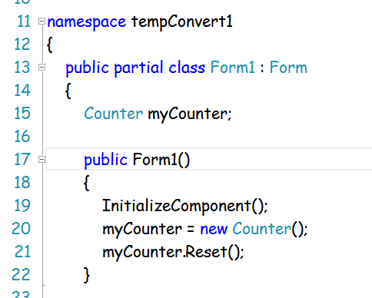
Form Class Code
Now you can create an
object whenever
You need it.
When you need an object of your class, just create it and store
The reference to it in the reference you declared earlier. Now the
object can be seen from anyplace in the Form code.

Slide 33
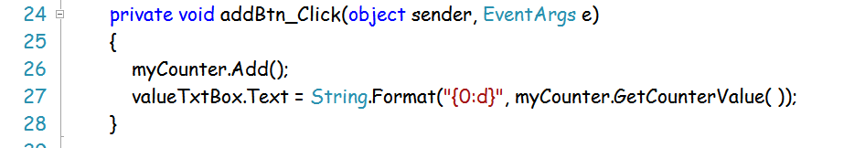
For example, this event handler uses the GetCounterValue method
That belongs to the Counter object we created in the previous slide.

Slide 34
Static Data Members
Normally, each object of a class keeps its own copy of the
data members defined in the class.
class Book
{
private double price;
…
}
book2
price
$85.00
book3
price
$64.50
book1
price
$75.95

Slide 35
Static Data Members
When a data member is declared as static, there is only
one copy of the variable, and it is shared by all object of
the class. This data is stored in the data segment.
class Book
{
private static double price;
…
}
book2
price
price
$64.50
book3
price
book1
price

Slide 36
Static Member Methods
Member methods of a class can also be declared as static.
A static method can be invoked without an object
of the class ever having been created.
As a result, static methods cannot do anything that
depends on there being a calling object. In particular, a static
method cannot use non-static member data.
Static member functions are invoked using the class name:
Book.SetPrice (54.00);

Slide 37
Now you can see why the method Main( )
is declared as static. We can invoke Main( )
without ever creating an object.

Slide 38

A Class Design Exercise

Slide 39
A Class Design Exercise
Design a class for a combination lock. To open the lock
you would turn the dial right to the first number, left
to the second number, and finally right to the last number.
Define the following operations:
a constructor( int, int, int );
void TurnLeft ( int n ); // turns the dial right to the number n
void TurnRight( int n ); // turns the dial left to the number n
bool Open( ); // returns true if the lock opens
void Reset( ); // resets the lock, ready to try again

Slide 40
A Class Design Exercise
Design the class, create a class diagram
Code up the class
Create a very small driver to test it
create a lock object
dial the combination
try to open it
print a message

